Slide 1
Chapter 6 Tutorial

Slide 2
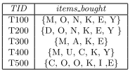
Q6
A database has 5 transactions. Let min sup = 60% and min conf = 80%.
Find all frequent itemsets using Apriori and FB-growth.
List all of the strong association rules (with support s and confidence c) matching the following metarule, where X is a variable representing customers, and item i denotes variables representing items (e.g., “A”, “B”, etc.):

Slide 3
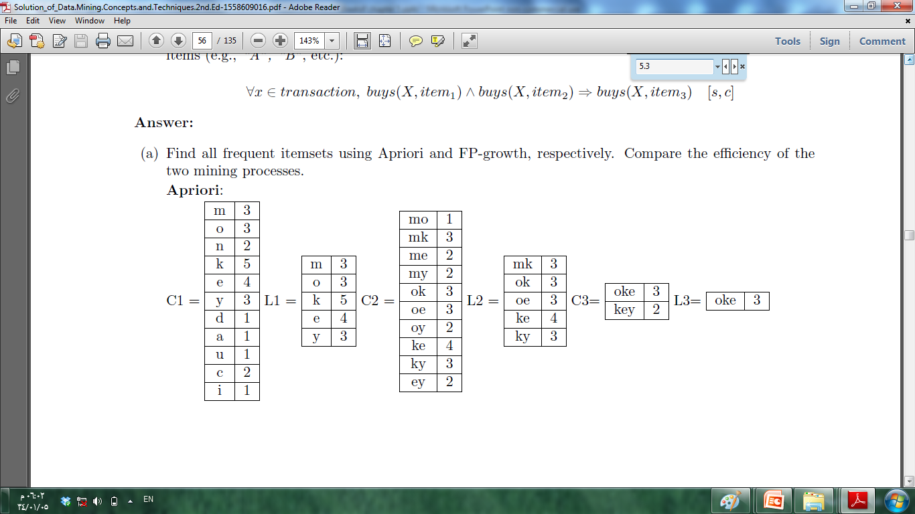
Q6.a Apriori algorithm
Finally resulting in the complete set of frequent itemsets:
{ e, k, m, o, y, ke, oe, mk, ok, ky, oke }

Slide 4
Q6.a FB-Growth algorithm
Scan DB once, find frequent 1-itemset (single item pattern) their support => 3
M | 3
O | 3
N | 2
K | 5
E | 4
Y | 3
D | 1
A | 1
U | 1
C | 2
I | 1
K | 5
E | 4
M | 3
O | 3
Y | 3
After checking support
TID items bought (ordered) Frequent items
T100 {M, O, N, K, E, Y} K,E,M,O,Y
T200 {D, O, N, K, E, Y } K,E,O,Y
T300 {M, A, K, E} K,E,M
T400 {M, U, C, K, Y} K, M, Y
T500 {C, O, O, K, I ,E} K,E,O

Slide 5
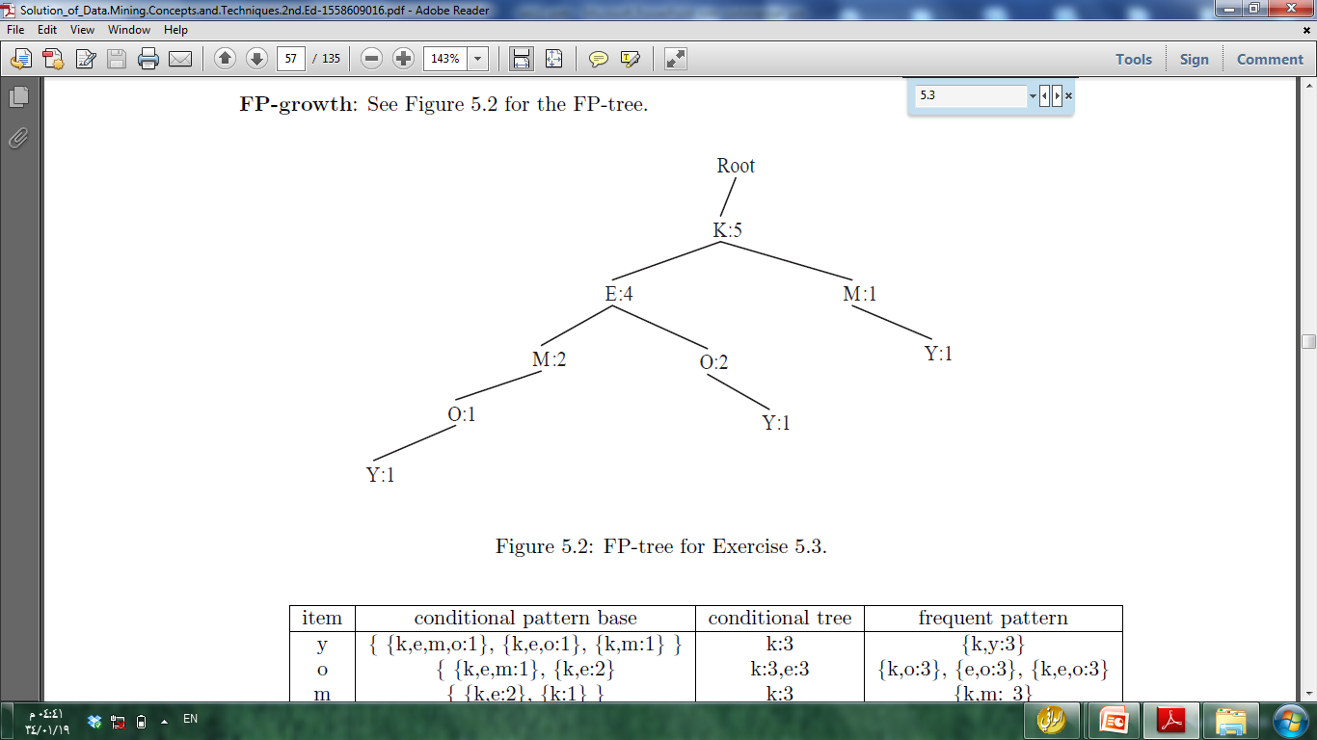
Q6.a FB-Growth algorithm
Generate FB-tree

Slide 6
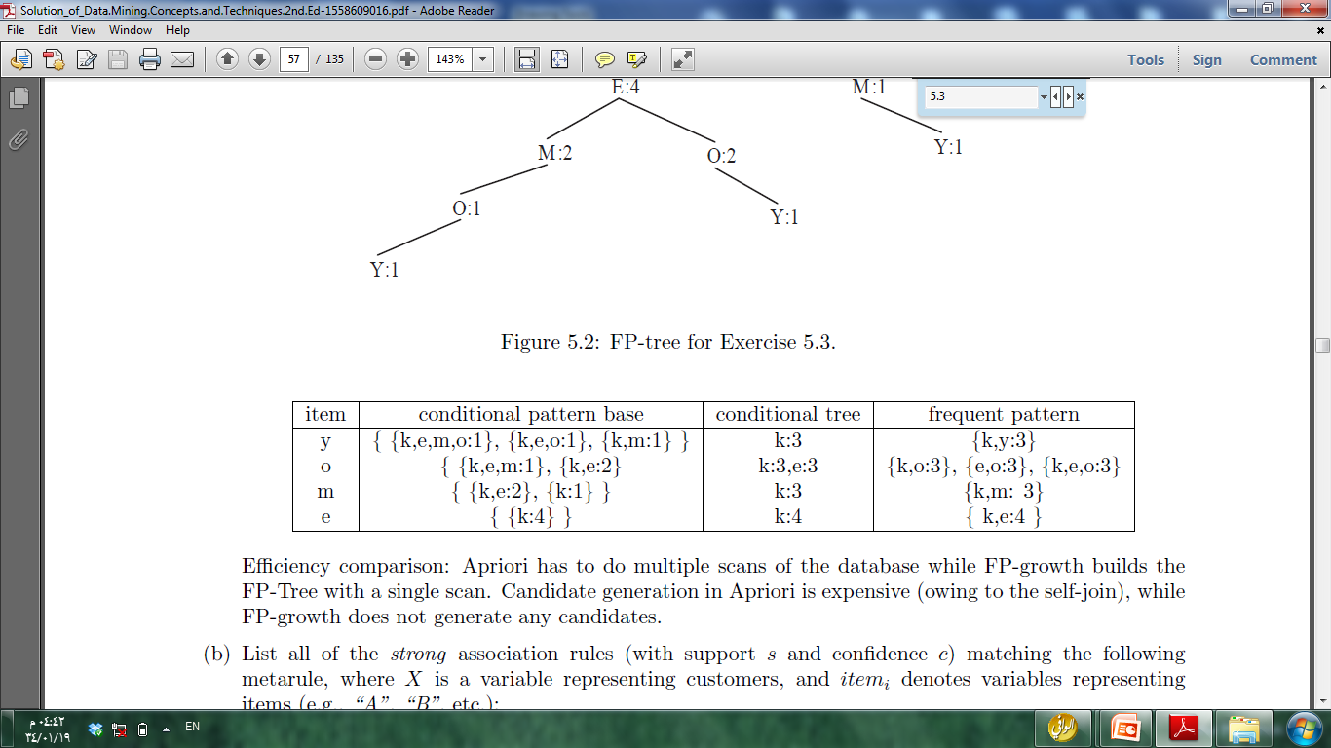
Generate FB-tree – order table

Slide 7
Q6.b
buys(X,k) Λ buys(X,o) => buys(X, e) [60%,100%]
buys(X,e) Λ buys(X,o) => buys(X, k) [60%,100%]

Slide 8
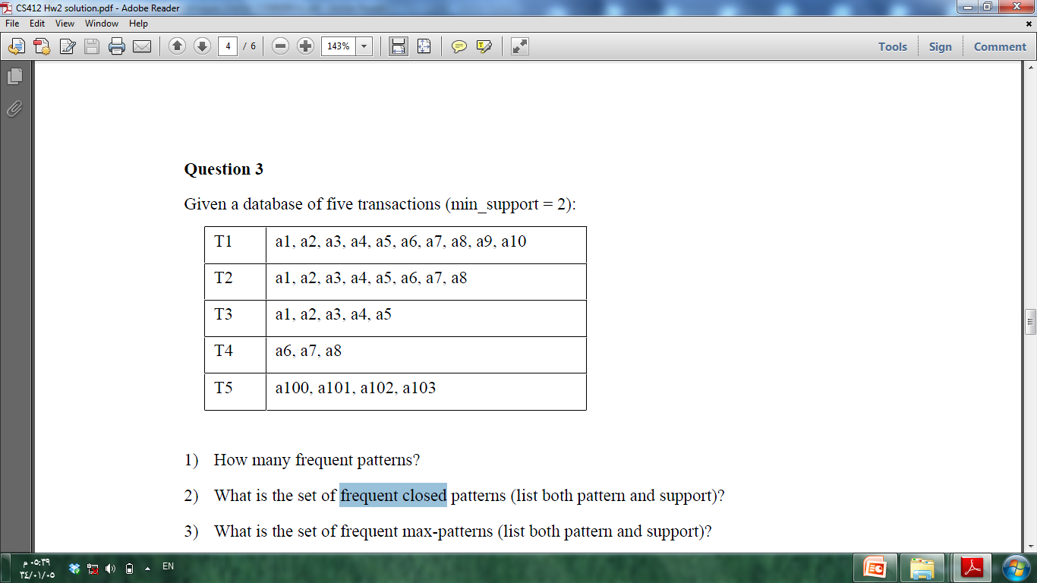
Exercise 1

Slide 10
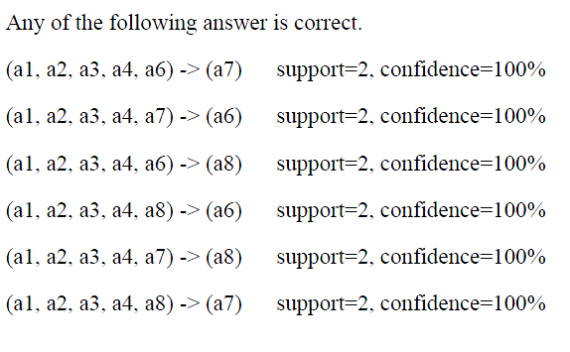
Show an example association rule that matches (a1, a2, a3, a4, itemX) -> (itemY) [min_support = 2, min_confidence=70%]

Slide 11
For association rule a1->a6, compute the confidence
confidence = p(a1 a6)/p(a1) = (2/5)/(3/5) = 2/3=0.67

Slide 12
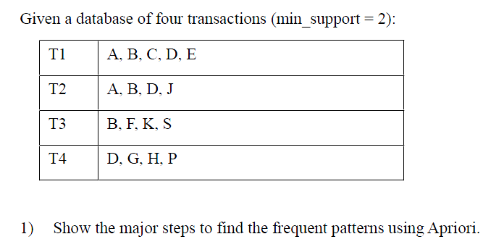
Exercise 2

Slide 13
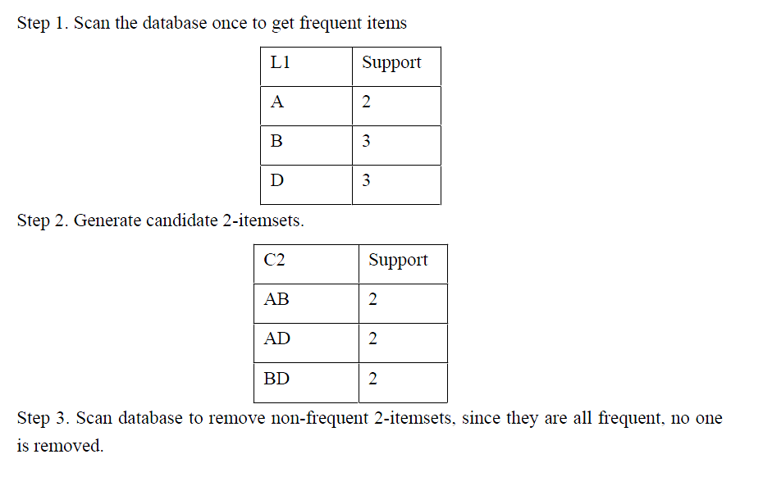

Slide 14
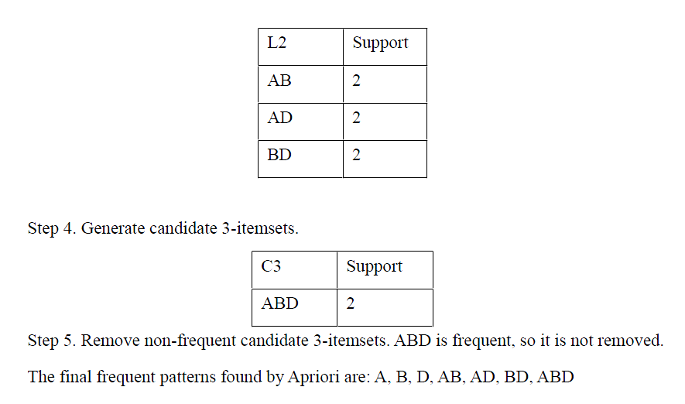

Slide 15
Activity
a dataset has eight transactions. Let minimum support = 50 %.
Find all frequent itemsets using FP-Growth
TID | Item bought
T1 | {W, O, R, N}
T2 | {W, T, U, G}
T3 | {X , T, U, G}
T4 | {S ,N, T, U, G}
T5 | {B ,R, G, T, D}
T6 | {T, X, I, L, U}
T7 | {G, U, R, T, X}
T8 | {X, O, N, G, T}

